Slide 1

Economic Growth within Natural Limits
November 6, 2013
Asif Saeed Memon
Sustainable Development Policy Institute

Slide 2
A rising tide …
Economic growth is good
Because “a rising tide lifts all boats”
And there is some evidence that this may be correct …
… if all boats are analogous to the percentage of the population living below a pre-determined poverty line: e.g. $1 a day

Slide 3
Growth & Inequality in the last decade

Slide 4
Critiques
The pursuit of GDP growth (1960’s onwards) has been accused of ignoring, at various times,
  Income inequality (relative poverty)
  Human development (education, health, the status of women)
  Environmental issues, natural limits & climate change

Slide 5
Responses to the critiques
Kuznet’s Curve:
  Inequality rises as GDP per capita increases and then declines
Millenium Development Goals (2000):
  The incorporation of the critique of economic growth into the long-term development framework
  Multi-dimensional poverty indicators

Slide 6
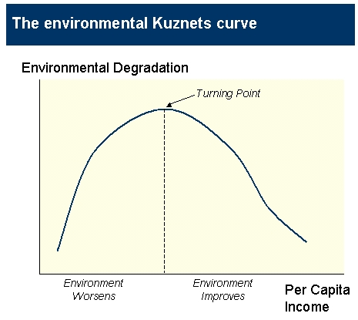

Slide 7
Findings on the EKC
The findings about the EKC are very mixed.
As income rises, environmental degradation HAS increased. Examples include China, India
According to the World Bank the costs of environmental degradation to India represent 5.7% of GDP
So, increase in environmental degradation as incomes rise has been confirmed by data.
But the posited subsequent reduction in depends on the context and the nature of growth.

Slide 8
Findings on the EKC in South Asia

Slide 9
The ghost of Malthus
It is true that natural resources can no longer be considered exogenous to the economic growth function.
  Peak oil
  Dwindling water resources
  Food price spikes
But does it matter if we deplete natural resources (endowment) if we are raising living standards and …
… will technology come to the rescue?
  Industrial revolution (18th to 19th century)
  Green revolution (Mid-20th century)
  Information technology revolution (Turn of century)
  A different kind of green revolution (21st century)?

