Slide 1

The Post-MDG Scenario in Pakistan: Beyond Data
Asif Saeed Memon
October 15, 2014
Sustainable Policy Development Institute

Slide 2
Background

Slide 3
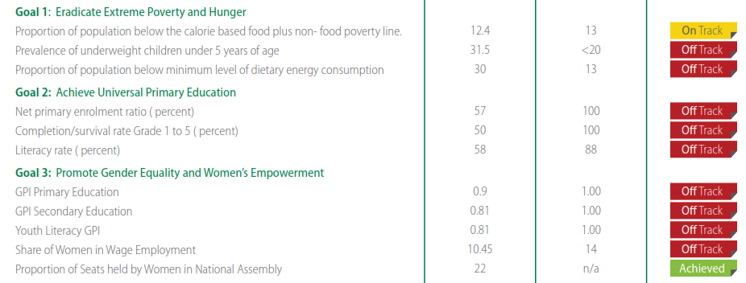
Pakistan’s performance on the MDGs

Slide 4
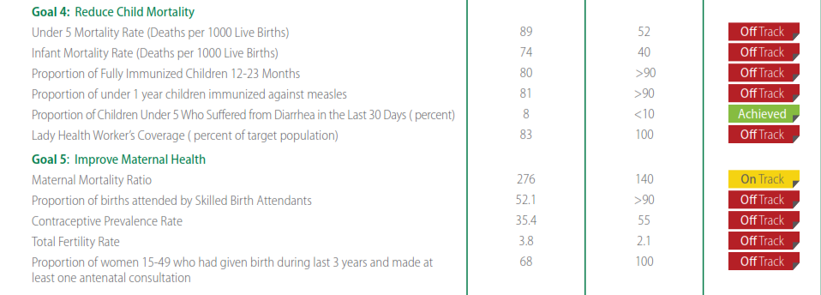
Pakistan’s performance on the MDGs

Slide 5
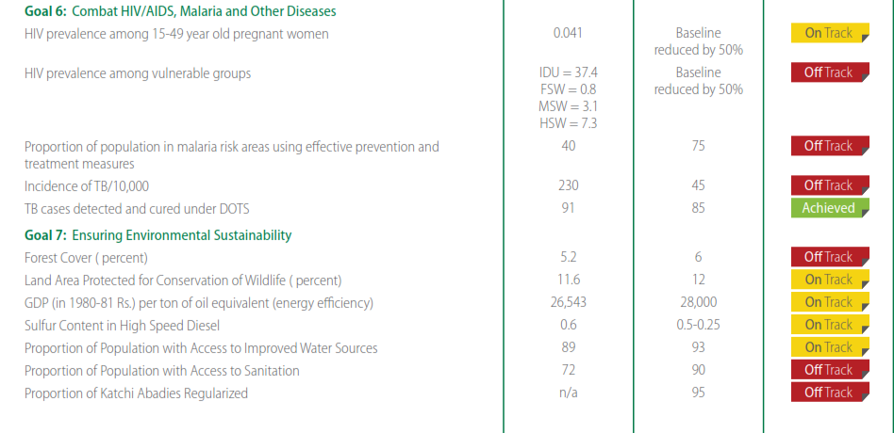
Pakistan’s performance on the MDGs

Slide 6
Data weaknesses
  No census since 1998
    All subsequent survey data do NOT take in to account internal displacement, migration and other demographic changes
  Sampling biases
    Internal displacement due to militancy, flooding, etc.
    Internal migration
  The centrality (or not) of data & evidence
    Policymakers, politicians, media & policy analysts as well as the donor community.
    Dearth of impact evaluations mean there is no real clue about the MoIs.
  Poor timeliness of data availability
    In December 2015 we will have access to 2014 statistical reports, which will be based on data collected in 2013

Slide 7
What next?
Moving beyond the data issues

Slide 8
The challenges of universality: Pakistan’s national context
What is Pakistan’s development agenda?
  Poverty (Economic growth, inflation, & redistribution)
  Education (Universal Primary & Secondary education; Article 25-A)
  Gender Equality (Contested territory)
  Maternal & Child Mortality (Lags MDGs, societal disinterest)
  Diseases (Lags MDGs; practically very reactive; example of vaccinations )
  The environment (Energy & Water)
  Global partnership (Trade)

Slide 9
The challenge of within country variation
Large inter provincial and intra provincial variations
Devolution of powers (18th amendment of constitution, 2010) means that there isn’t a functional system of national planning and cooperation in place. Evolving but contested. UNDP is doing well at working with individual provinces.
This is where political challenges will become increasingly difficult to face (examples of Punjab)
Devolution means the capacity issues are getting exacerbated
  Best case: Things will get worse before they get better

Slide 10
Means of implementation
We don’t really know which implementation tools are working and which are not
Impact evaluations are either non-existent or poor
Hardly any use of experimental designs (counterfactuals, RCTs)
Poor regular monitoring of progress

Slide 11
Resources
Pakistan’s development budget forecast is for the next phase of development goals can best be described as barren.
No chance of administrative, military and debt servicing spending growth letting up
This may change post devolution if economic growth and tax to GDP ratio rise unexpectedly
Therefore will be reliant on bilateral and multilateral aid

Slide 12
Local stakeholders & Accountability
Local stakeholders (CSOs, media, rights based groups, etc.) have played a positive role in Pakistan on the adoption of MDGs as national targets.
Despite their critique of the MDG framework these organizations have performed the role of holding the state accountable on performance of MDG achievement.
This should be expected to continue in the future.

Slide 13
Finally, what can we do about data challenges
Growth of private data collection for polling (Gallup, NDI, IRI, etc.) has direct and indirect impact (externalities)
Use of cellular technology for both dumb and smart phones (Pakistan’s cellular phone incidence is very high for it’s economic size 70 cellular subscriptions per 100 persons)
Bringing the state statistical arms along
Census!

Slide 14
Thank you
asifmemon@sdpi.org
@asifsaeedmemon

